Slide 1
Model Parameters
Simple models like lenet-5 and modern models like resnet-18

Slide 2
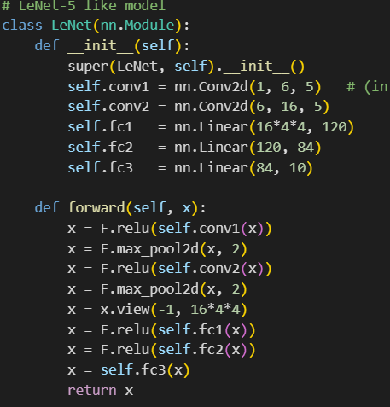
Output = (I*k) + b
I = input
K = filter weights
b = bias
The bias term b is a single scalar added to every element of the feature map produced by that filter.
-Each filter is detecting a specific feature (like an edge, curve, texture).
-The bias allows the filter to shift the activation up or down, independent of the input.
In convolution:
Parameter count = 6*(1*5*5+1) = 156 weights + bias.
Or
(1×5×5)×6+6 =25×6+6= 150+6=156 parameters, meaning
In fully connected layers:
Parameter count = 256×120+120 = 30,840.

Slide 3
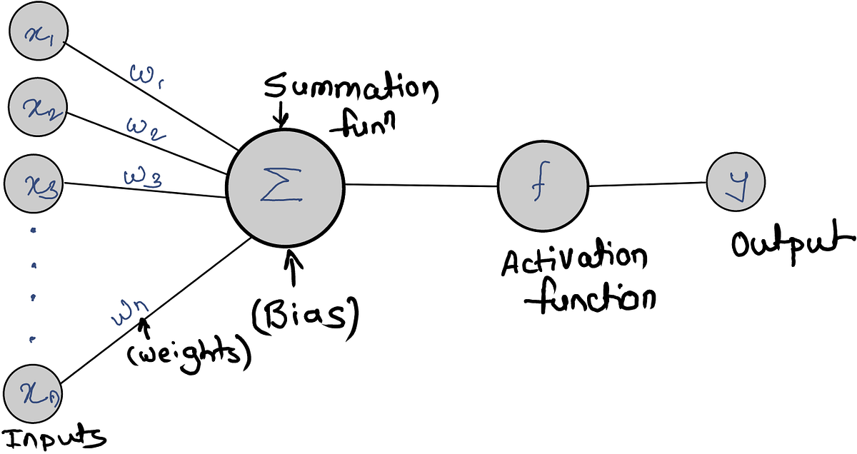

Slide 4
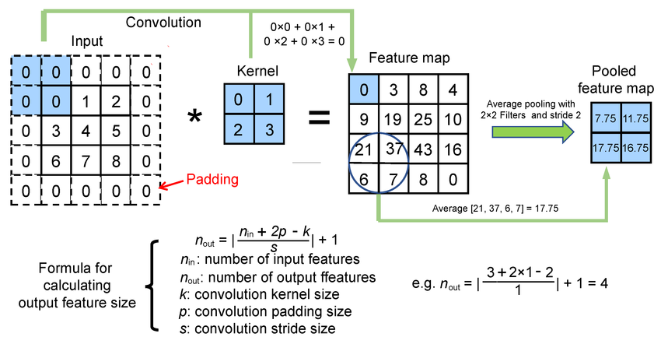

Slide 5
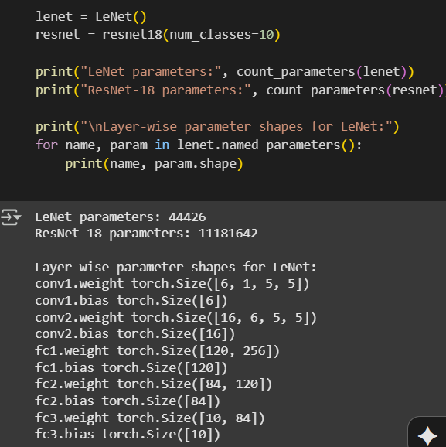
Layer-wise parameters for lenet-5

Slide 6
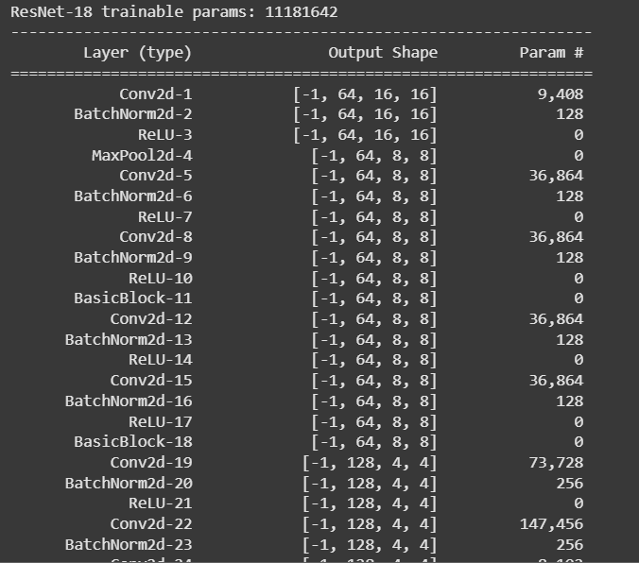
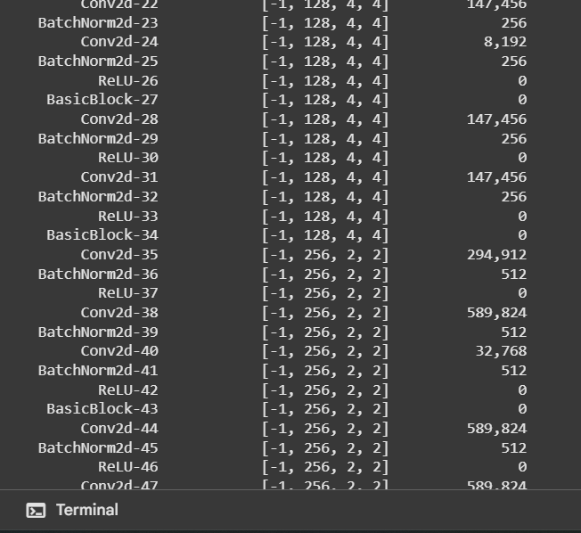
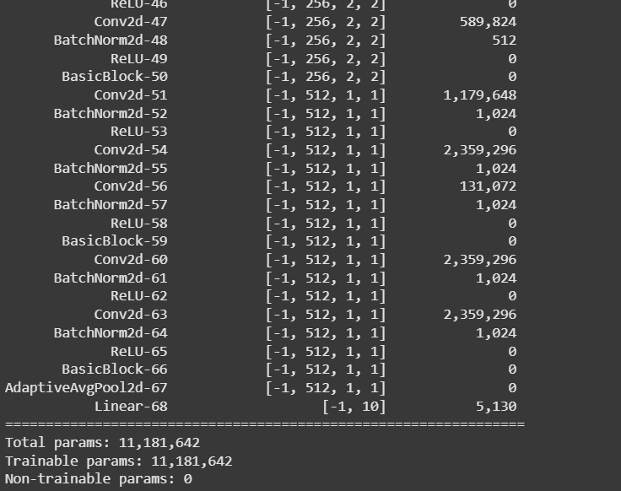
Resnet-18 Parameters by layer

Slide 7
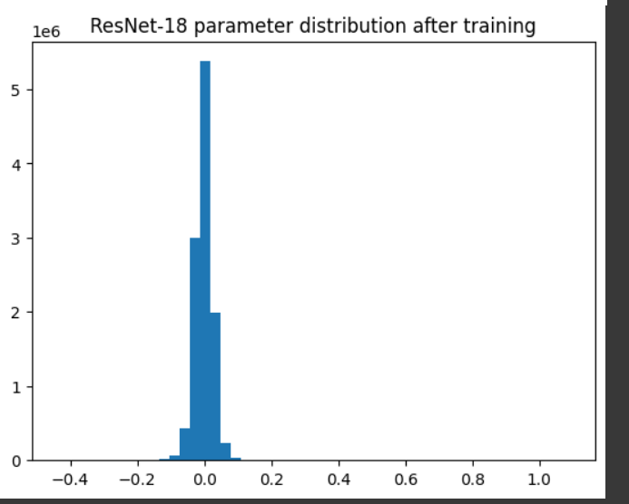
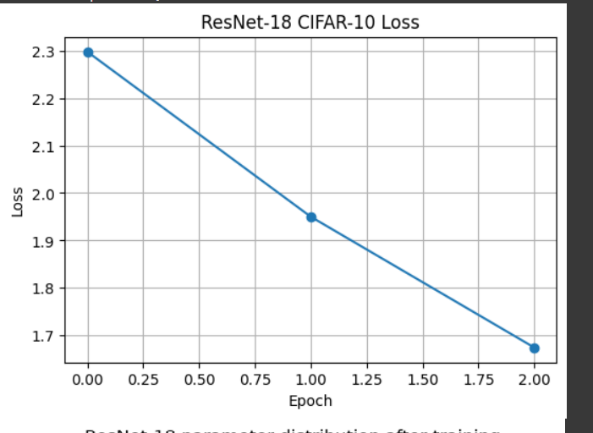
Resnet parameters after training

Slide 8
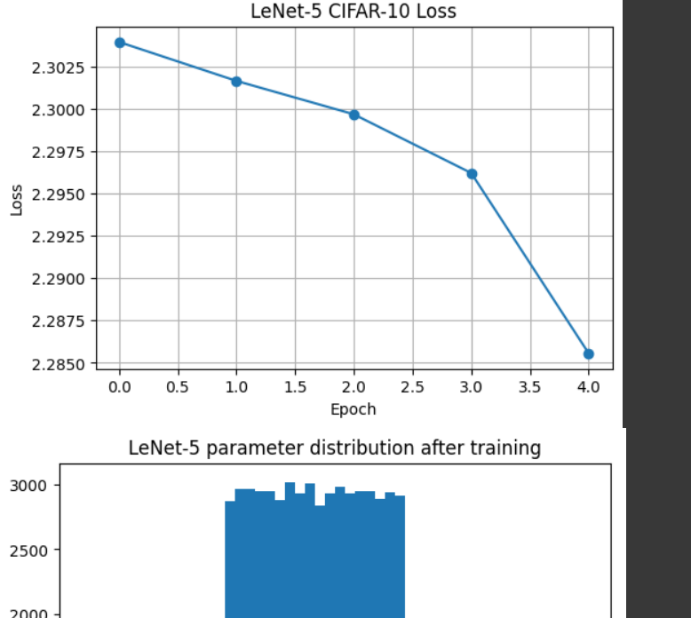
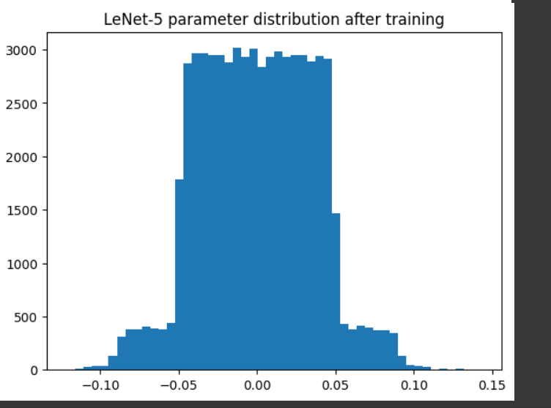
Lenet paramters after training

